Slide 1
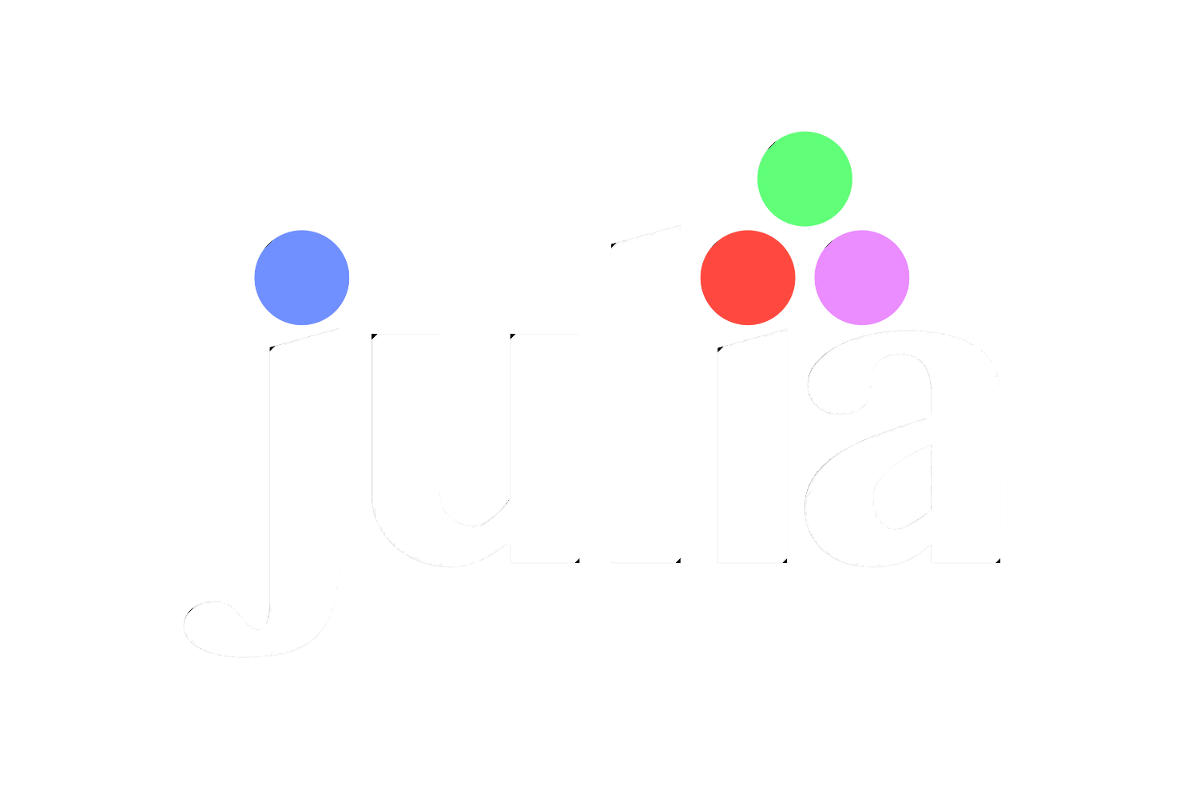

For Beginners!
© Copyright Matthew Flood, 2022

Slide 2
For Beginners!
Week 6:
What is DataFrames.jl?
DataFrames 101
Data Visualization

Slide 3
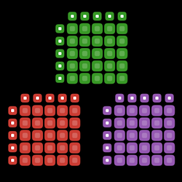

Relationship to R & Pandas
DataFrames.jl is a package for manipulating and analysing data.
It is basically Microsoft Excel on steroids...
When you want to work with tabular data of different types (numbers and text), you’ll use DataFrames
The tools provided with DataFrames.jl resemble those provided by other ecosystems like R and Pandas.
DataFrame objects are integral to Julia programming, and can be used with functions in statistics, machine learning, and plotting packages.

Slide 4

DataFrames 101
Under the hood, DataFrames.jl uses a lot of the functions provided by Tables.jl.
When we want to import data as a DataFrame object, we need to use our old friends:
DelimitedFiles.jl
CSV.jl

Slide 5
Create DataFrames from imported data
Example:
julia> using DelimitedFiles, DataFrames
julia> FileData, _ = readdlm(“MyFile.txt”, ‘,’,header=true)
julia> Data = DataFrame(FileData, :auto)
Example:
julia> using CSV, DataFrames
julia> FileData = CSV.read("StudyData.csv", DataFrame)

Slide 6
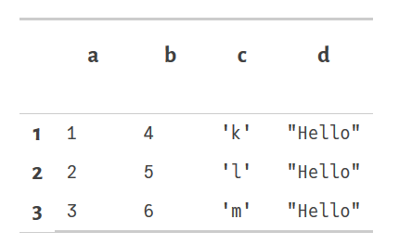
Create DataFrames from scratch
Example:
julia> X = DataFrame(a = [1,2,3],
b = 4:6,
c = ‘k’:‘m’,
d = “Hello”)

Slide 7

Useful common functions
first()
last()
describe()
names()
propertynames()
select()
sort()
hcat()
vcat()
unique()
groupby()
filter()
dropmissing()

Slide 8
DataFrames CheatSheet

Slide 9

For Beginners!
Homework Week 6:
There is none!!

Slide 10

For Beginners!
We have an final assignment instead! ☺

Slide 11

Like learning a real language, the only way to become fluent is to practice.
OK, let’s start writing some code!!!

